Slide 1
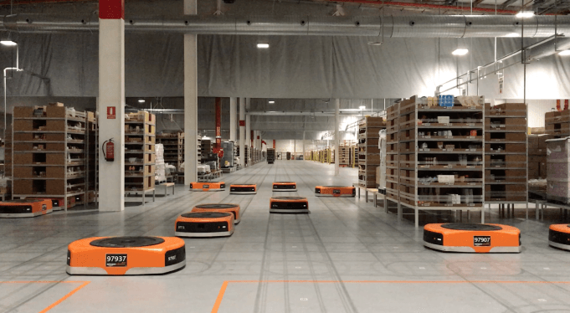
Amazon Robotics machines in a Amazon warehouse
Path planning for a fleet of robots
Luca Marseglia

Slide 2
Summary
Brief recap on the previous algorithm
Introduction, results and simulations with the new algorithm for a fleet of robots
Simulations with evidence of new issues
2024 August | Slide 2

Slide 3
Recap: Prioritized Collision Avoidance
Two different algorithms for collision avoidance were developed. They both focused on changing the maximum travel velocity of the robot to avoid collisions:
The first one considered the best combination of maximum velocities among all the possible collision free combinations. But computing all the possible combinations takes long execution times
2024 September | Slide 3

Slide 4
Recap: Prioritized Collision Avoidance
The second one is based on priorities to improve significantly the execution time:
Each robot is assigned a priority based on the length of their path
Then the trajectory of the highest priority robot (the one with the longer path) is planned at the maximum velocity
Then the trajectory of the second robot is planned. Its maximum velocity is decreased until there is no collision with the previous robots
The iterations continue until all the trajectories have been planned.
2024 September | Slide 4

Slide 5
Algorithm for a fleet of robots
2024 September | Slide 5

Slide 6
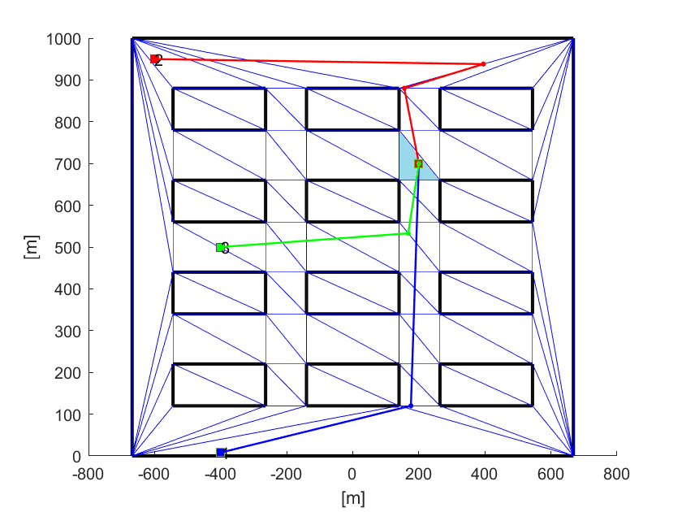
Basic idea
Given n different paths, the idea is to build a «snake» corridor that starts from the goal point, so as to constrain the trajectories to navigate in the same corridor.
2024 September | Slide 6

Slide 7

Basic idea
The corridor moves in the direction where there are more paths, so as to maximize the trajectories that have a common path.
2024 September | Slide 7

Slide 8
Basic idea
To do so, the algorithm exploits the triangulation and moves across each triangle at each iteration.
At each iteration, an obstacle is created between the current triangle and the triangle that contains less paths, so as to move in the direction containing more paths and build a corridor around them.
The steps of the algorithm are:
Starting from the goal point, find all the adjacent triangles
Among these, only consider the triangles that contain a path
Among these:
Create an obstacle between the current triangle and the triangle that contains less paths.
Don’t create the obstacle if the previous triangle has been already visited.
Move to the triangle that contains more paths and restart from point 1
2024 September | Slide 8

Slide 9
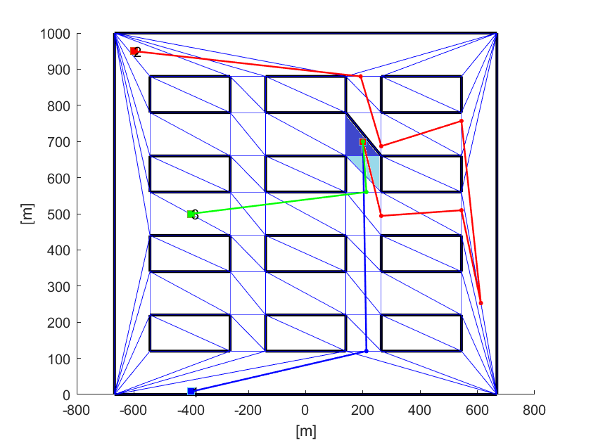
1 iteration
At the first iteration, the current triangle is the goal point.
An obstacle is created between the current triangle and the triangle containing less paths.
For now, the triangle that does not contain any path has been ignored.
The next triangle is this one
2024 September | Slide 9

Slide 10
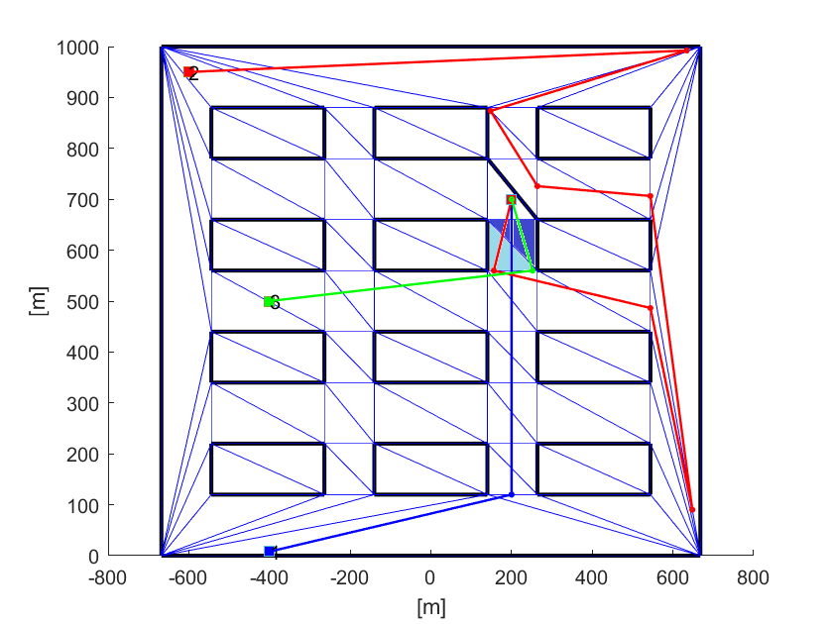
2 iterations
The previous triangle is ignored, because it’s already visited.
This triangle is ignored, because it’s an obstacle
This is selected as the next triangle
2024 September | Slide 10

Slide 11
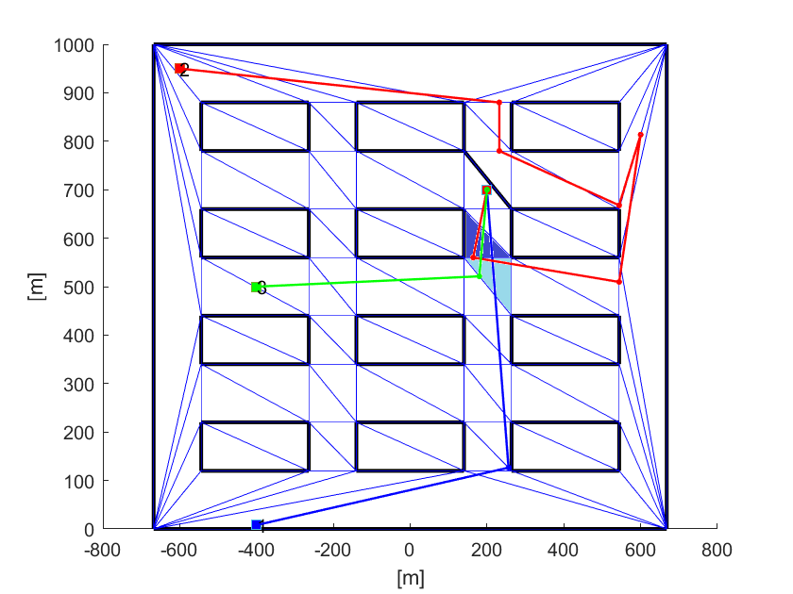
3 iterations
Same scenario as the previous iteration
2024 September | Slide 11

Slide 12
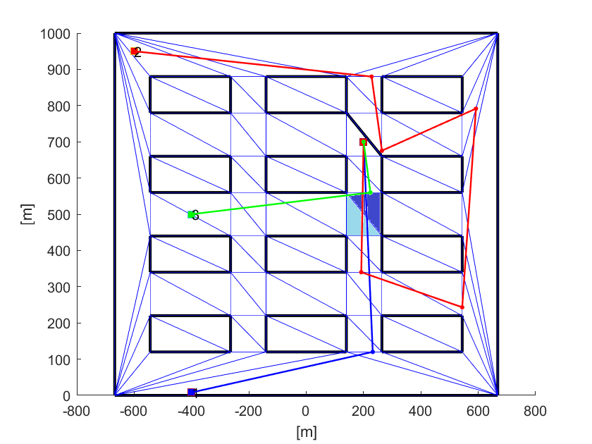
At this point, the obstacle can be added on either of the two adjacent triangles, as they contain the same number of paths.
For now, it is added randomly, but a heuristic for the choice can be defined in the future.
4 iterations
3 iterations
4 iterations
2024 September | Slide 12

Slide 13
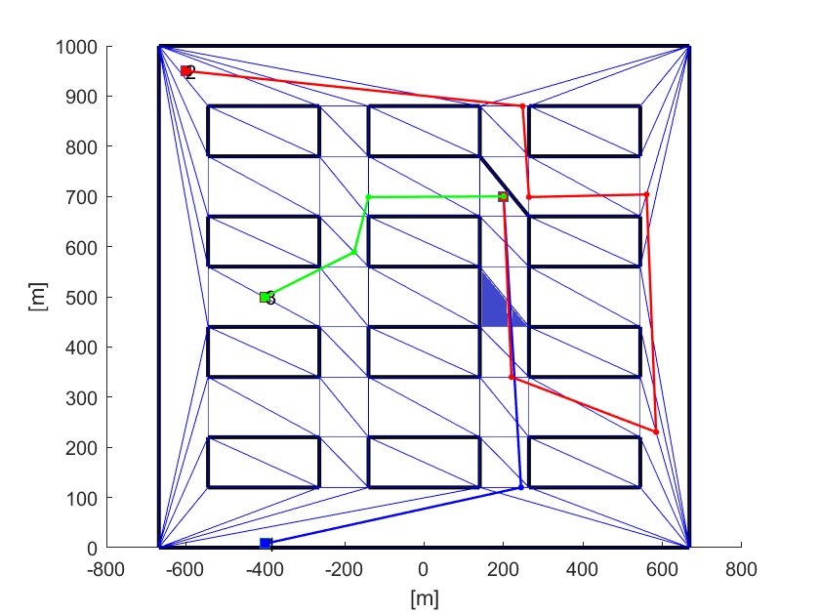
5 iterations
After 5 iterations, a corridor is created, but the green robot finds a shorter path that is different from that of the others.
2024 September | Slide 13

Slide 14
5 iterations
For this reason, the triangles that do not contain any trajectory cannot be ignored.
1 iteration
5 iterations
2024 September | Slide 14

Slide 15
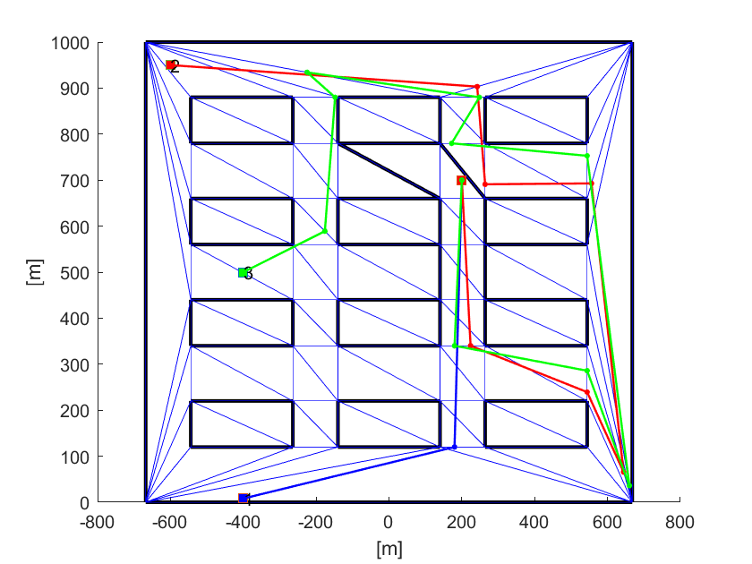
5 iterations
The obstacle cannot be placed here otherwise the algorithm gives an error, but it can still be placed on the other edge
2024 September | Slide 15

Slide 16
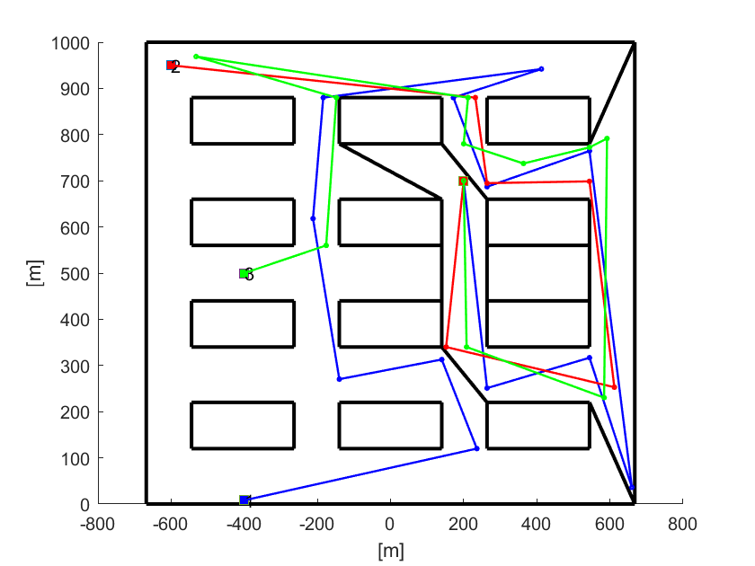
17 iterations
This is the result after 17 iterations.
2024 September | Slide 16

Slide 17
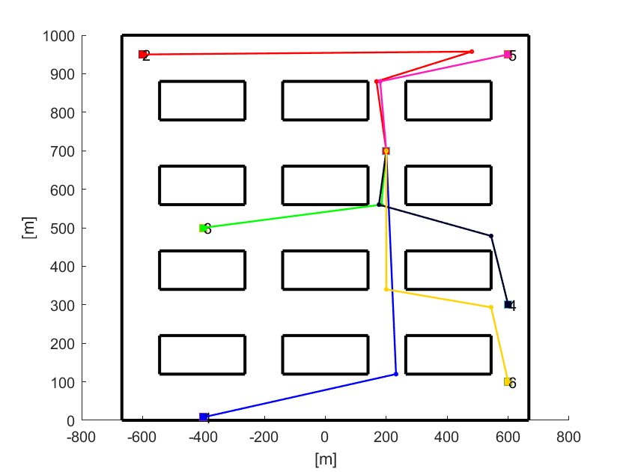
6 paths
Now we’ll try the algorithm with 6 robots, to test the collision avoidance algorithm.
2024 September | Slide 17

Slide 18
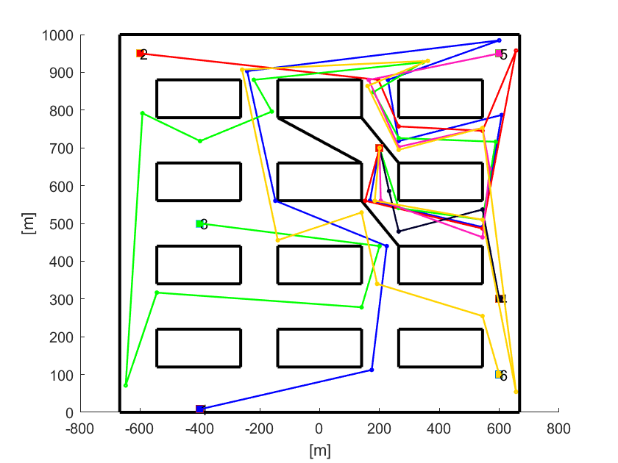
6 paths: 5 iterations
And this is the result after 5 iterations.
2024 September | Slide 18

Slide 19
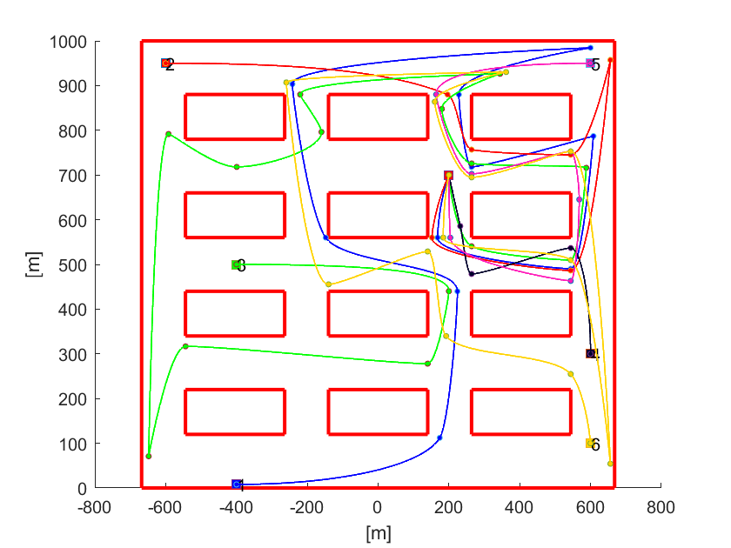
6 paths: interpolation
2024 September | Slide 19

Slide 20
Simulations and issues
2024 September | Slide 20

Slide 21
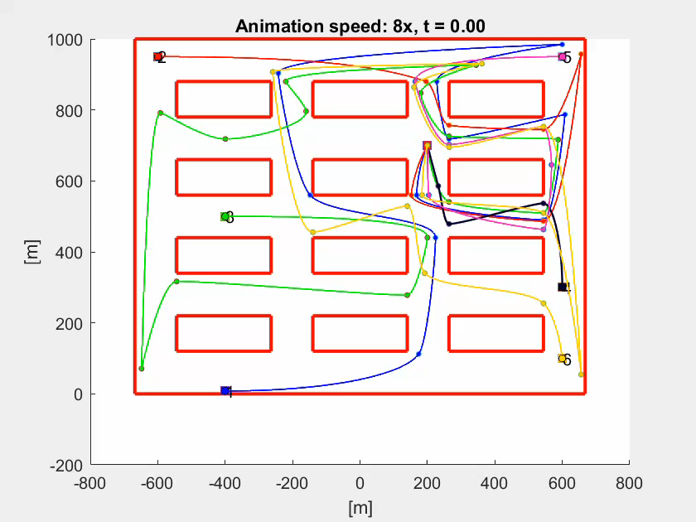
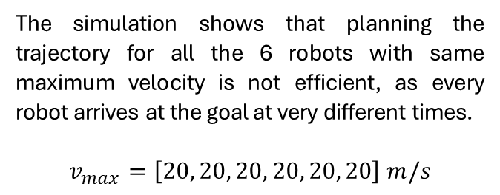
Simulation of the planned trajectories
The simulation shows that planning the trajectory for all the 6 robots with same maximum velocity is not efficient, as every robot arrives at the goal at very different times.
$$v_{max}=\left[20, 20, 20, 20, 20, 20\right] m/s$$
2024 September | Slide 21

Slide 22

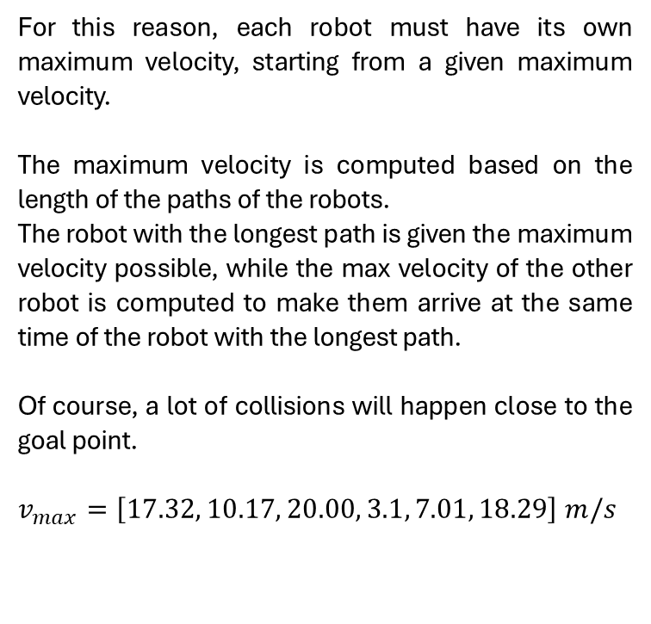
Adjusting max velocities for coordination
For this reason, each robot must have its own maximum velocity, starting from a given maximum velocity.
The maximum velocity is computed based on the length of the paths of the robots.
The robot with the longest path is given the maximum velocity possible, while the max velocity of the other robot is computed to make them arrive at the same time of the robot with the longest path.
Of course, a lot of collisions will happen close to the goal point.
$v_{max}=\left[17.32, 10.17, 20.00, 3.1, 7.01, 18.29\right] m/s$
2024 September | Slide 22

Slide 23
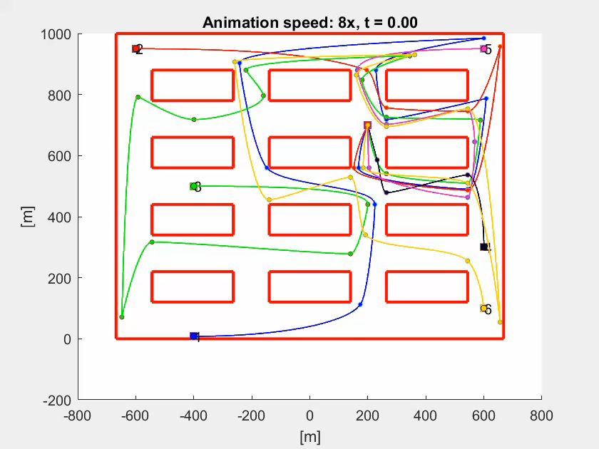
Applying the collision avoidance algorithm
The collision avoidance algorithm works properly, but it shows some problems.
The pink robot has a very small maximum velocity, because it has to avoid a high number of robots very early, and so, since the pink robot has the lowest priority, it has to slow down to let them pass first, because they have the longest past and thus the highest priority.
But then, the pink robot moves slowly for the rest of the path.
2024 September | Slide 23

Slide 24
Future work
When to stop the corridor algorithm? (Or which should be the «meeting point» of the robots?)
A fixed number of iterations
Centroid of the starting points
A certain distance from the goal point
Should the path length be «optimized»?
Improve the collision avoidance algorithm to solve the latest issue
The heuristic must be changed? → The current heuristic for the choice of the priorities is the length of the paths. It can be changed to be the number of paths that intersect the robot’s path (the robot that intersects the most paths has the highest priority)
2024 September | Slide 24

